Slide 1

Sequential Chat
Apoorv Vishnoi
Head of Training, Analytics Vidhya
Notes:
Welcome back, everyone! In the last lesson, we explored various conversation patterns in AutoGen. In this lesson, we'll dive into the next pattern: Sequential Chats.

Slide 2
Sequential Chat
Context
Context
Context
Context
Message
Message
Message
Message
Agent B
(Conversable Agent)
Agent C
(User Proxy Agent)
Agent D
(Assistant Agent)
Agent E
(Conversable Agent)
Carryover
Carryover
Carryover
Agent A
(Assistant Agent)
Agent A
(Assistant Agent)
Agent A
(Assistant Agent)
Agent A
(Assistant Agent)
Carryover
Carryover
Notes:
Sequential chats are a powerful communication pattern for AI agents.

Slide 3
Sequential Chat
Context
Context
Context
Context
Message
Message
Message
Message
Agent B
(Conversable Agent)
Agent C
(User Proxy Agent)
Agent D
(Assistant Agent)
Agent E
(Conversable Agent)
Carryover
Carryover
Carryover
Agent A
(Assistant Agent)
Agent A
(Assistant Agent)
Agent A
(Assistant Agent)
Agent A
(Assistant Agent)
Carryover
Carryover
Notes:
They enable multiple agents to interact in a step-by-step manner, passing context or history from one chat to the next through a mechanism called carryover. The carryover in sequential chats is not limited to being passed from one chat to the next. Instead, the carryover from each previous chat is shared across with all subsequent chats in the sequence.

Slide 4
Sequential Chat
Context
Context
Context
Context
Message
Message
Message
Message
Agent B
(Conversable Agent)
Agent C
(User Proxy Agent)
Agent D
(Assistant Agent)
Agent E
(Conversable Agent)
Carryover
Carryover
Carryover
Agent A
(Assistant Agent)
Agent A
(Assistant Agent)
Agent A
(Assistant Agent)
Agent A
(Assistant Agent)
Carryover
Carryover
Notes:
This means to generate the final response the last set of agents will have access to the full context of the conversation. Agents in a sequential chat can vary throughout the sequence.

Slide 5
Sequential Chat
Context
Context
Context
Context
Message
Message
Message
Message
Agent B
(Conversable Agent)
Agent C
(User Proxy Agent)
Agent D
(Assistant Agent)
Agent E
(Conversable Agent)
Carryover
Carryover
Carryover
Agent A
(Assistant Agent)
Agent A
(Assistant Agent)
Agent A
(Assistant Agent)
Agent A
(Assistant Agent)
Carryover
Carryover
Notes:
For example in the the following chat agent A is getting repeated in all chats in the sequence.

Slide 6
Sequential Chat
Context
Context
Context
Context
Message
Message
Message
Message
Agent B
(Conversable Agent)
Agent C
(User Proxy Agent)
Agent D
(Assistant Agent)
Agent E
(Conversable Agent)
Carryover
Carryover
Carryover
Agent A
(Assistant Agent)
Agent B
(Assistant Agent)
Agent C
(Assistant Agent)
Agent D
(Assistant Agent)
Carryover
Carryover
Notes:
Where as, in the following sequence, we have conversations happening between different agents.

Slide 7
Sequential Chat Process
Agent B
(Conversable Agent)
Initial Message
Agent A
(Assistant Agent)
Notes:
A sequential chat starts when: A conversation is initiated between two agents.

Slide 8
Sequential Chat Process
Agent B
(Conversable Agent)
Agent C
(User Proxy Agent)
Initial Message
Carryover
Agent A
(Assistant Agent)
Agent B
(Conversable Agent)
Notes:
Then, the result of their chat becomes the "carryover" for the next chat. It's like handing over the baton to the next runner in a relay race.

Slide 9
Sequential Chat Process
Agent B
(Conversable Agent)
Agent C
(User Proxy Agent)
Agent D
(Assistant Agent)
Initial Message
Carryover
Carryover
Agent A
(Assistant Agent)
Agent B
(Conversable Agent)
Agent C
(User Proxy Agent)
Notes:
After this, The next pair of agents takes this carryover as input.

Slide 10
Sequential Chat Process
Agent B
(Conversable Agent)
Agent C
(User Proxy Agent)
Agent D
(Assistant Agent)
Initial Message
Chat
Result
Summarizer
Carryover
Carryover
Carryover
Agent A
(Assistant Agent)
Agent B
(Conversable Agent)
Agent C
(User Proxy Agent)
Carryover
Notes:
As the chats continue, the carryover keeps accumulating. Each chat starts with all previous carryovers, so the sequence builds on earlier results. Now that we have discussed how a sequence chat works, let's understand the code structure to build a sequential chat pattern,

Slide 11
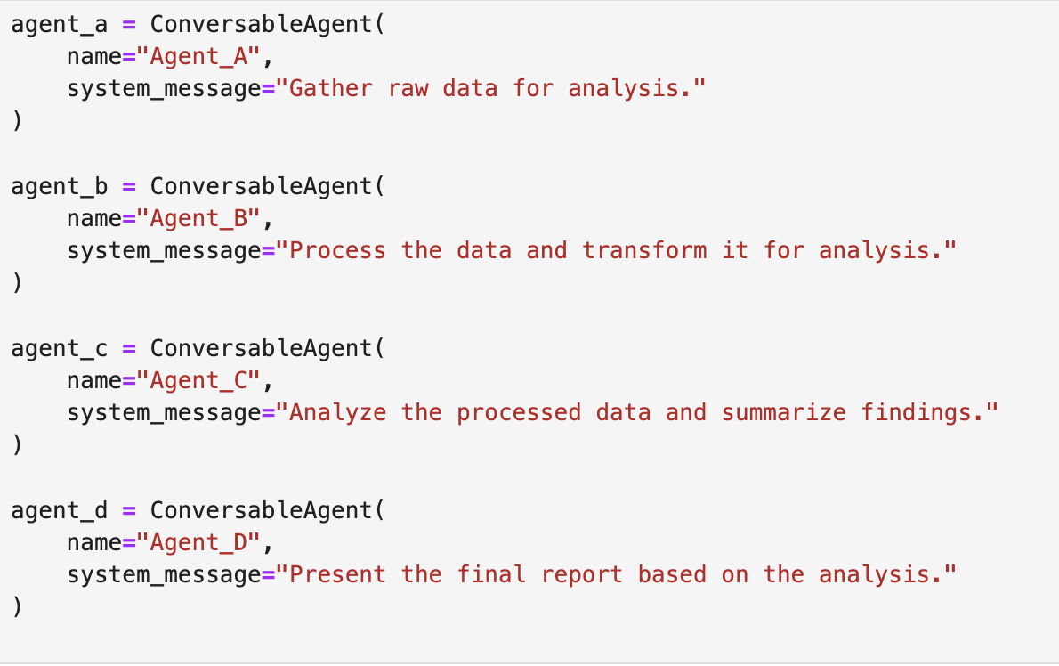
Sequential Chat Code Structure
Step 1 - Define Role of Each Agent
Notes:
Step 1 involves defining the Agents. Here we specify the role of each agent assigning a particular task to each one of them.

Slide 12
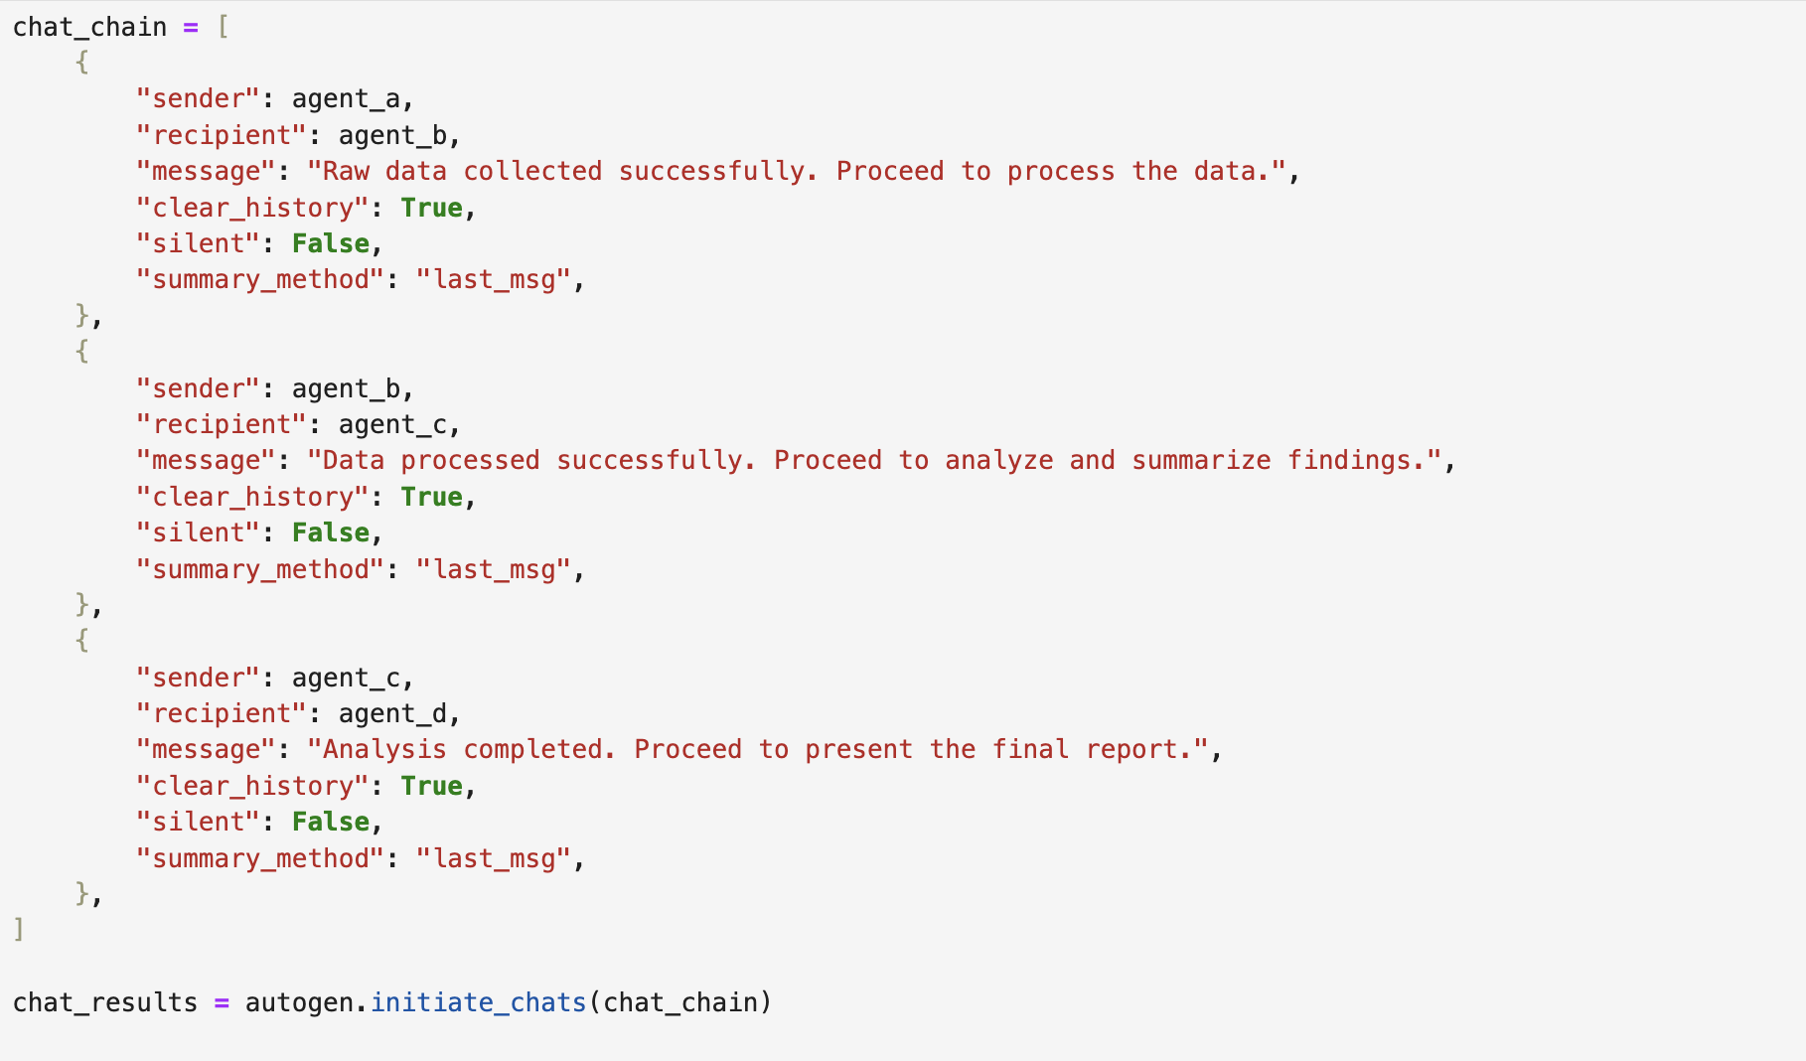
Sequential Chat Code Structure
Notes:
Step 2 is Chaining the Agents. Here we create a sequence which details how the conversation will take place between the agents. Within a chat sequence, the agent that starts or initiates the conversation becomes the sender agent while the other agent in the chat becomes the recipient agent.

Slide 13
Sequential Chat Code Structure
Notes:
The sequence of dictionaries in the chat chain represents the sequence in which the system interacts with agents. Once initialized, this is how a conversation takes place within a sequential Chat:

Slide 14
Sequential Chat Code Structure
Notes:
It starts with a first chat between two agents, its carryover goes to the next chat.

Slide 15
Sequential Chat Code Structure
Notes:
Then the next chat takes this carryover, as the input and use it to perform tasks and come out with a response.

Slide 16
Sequential Chat Code Structure
Notes:
The third chat will now get the carryover from both the previous chaats and the same process will continue.

Slide 17

Sequential Chat Code Structure
Notes:
Step 3 involves getting the final output. After all chats, you can review the results from each step using the command highlighted on the screen to get the summary from the first step. The number in this command can be modified to get the summary from the required step.

Slide 18
Applications of Sequential Chat
Notes:
Sequential chats are particularly effective for tasks requiring step by step execution. Let us explore some use cases.

Slide 19
Problem Solving
UserProxy
Agent
Modeling
Agent
Initial Message
Chat
Result
Summarizer
Carryover
Carryover
Data Cleaner Agent
Feature Engineering Agent
Notes:
For Example, A Data Cleaner Agent preprocesses raw data, a Feature Engineering Agent extracts features, and a Modeling Agent builds a predictive model.

Slide 20
Problem Solving
UserProxy
Agent
Summarizer Agent
Initial Message
Chat
Result
Analyser
Carryover
Carryover
Calculator Agent
Visualization Agent
Notes:
This can also apply to problem-solving, where one agent calculates, another visualizes, and the last analyzes the results.

Slide 21
Content Generation Pipelines
UserProxy
Agent
Formatter
Agent
Initial Message
Chat
Result
Summarizer
Carryover
Carryover
Writer Agent
Proofreader Agent
Notes:
Next is Content Generation Pipelines. For example: A Writer Agent creates the initial content, a Proofreader Agent ensures quality and a Formatter Agent finalizes it for publication.

Slide 22
Code Development and Testing
UserProxy
Agent
Tester
Agent
Initial Message
Chat
Result
Summarizer
Carryover
Carryover
Code
Writer Agent
Code Debug Agent
Notes:
Another application is Code Development and Testing. A Code Writer Agent develops a script, a Code Debug Agent checks for errors, and a Tester Agent runs tests for functionality.

Slide 23
Report Analysis
UserProxy
Agent
Presenter
Agent
Initial Message
Chat
Result
Summarizer
Carryover
Carryover
Data Retrieval Agent
Data Analysis Agent
Notes:
Next is Report Analysis. Here, a Data Retrieval Agent fetches a relevant report, a Data Analysis Agent analyses the report, and a presenter Agent delivers the key insights from the report.

Slide 24
Thanks!
Notes:
Sequential chat is ideal for workflows that require logical progression, where the output of one step feeds into the next. In the next lesson, we'll explore how to use this pattern to build the marketing campaign strategy for the launch of a product.

